Slide 1
ATMOS

Slide 2
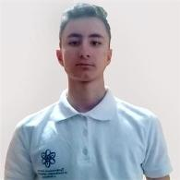
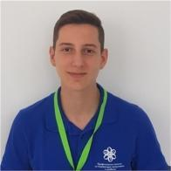
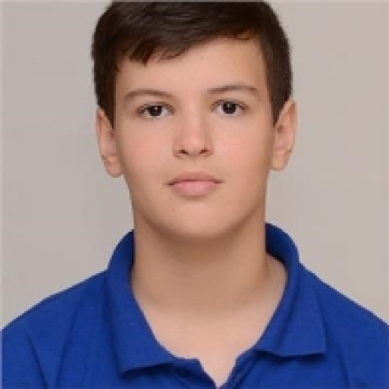
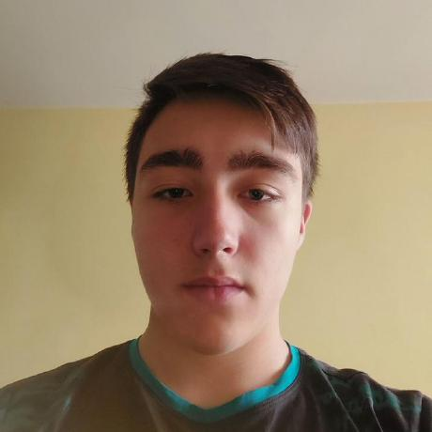
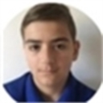
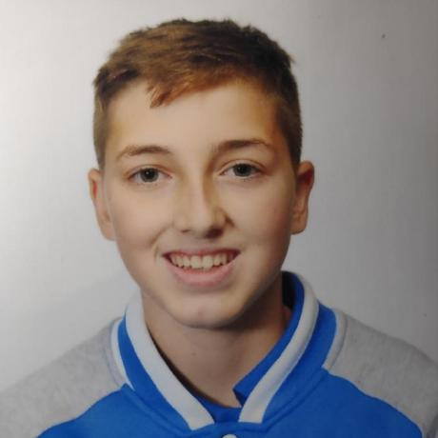
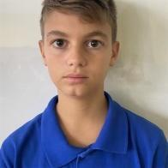
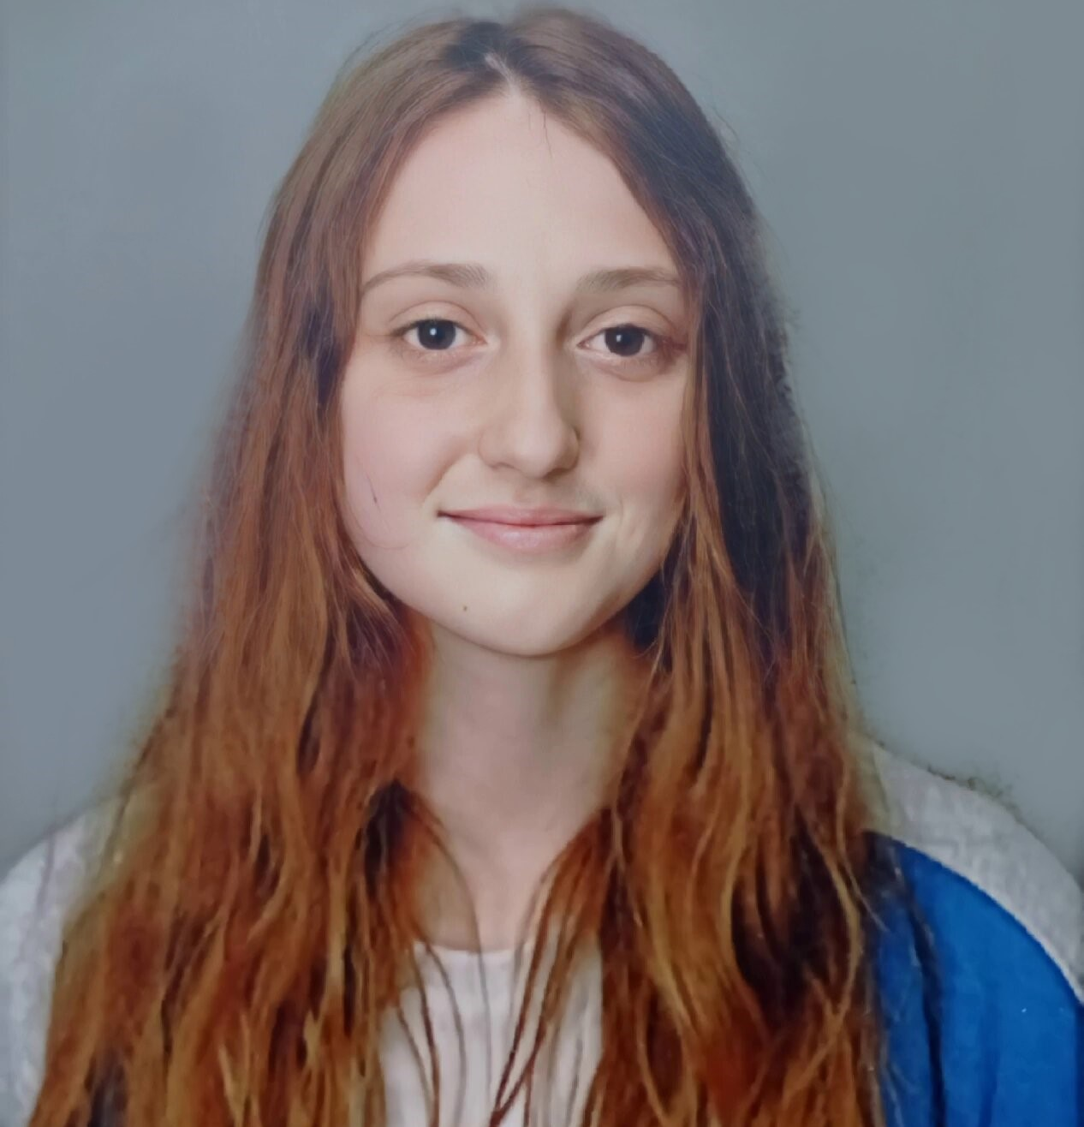
Our team
Boris Savov
Nikola Peshev
Valeri Ivanov
Stefan Hristov
Scrum Trainer/Backend
Scrum Trainer
Frontend Developer
Backend Developer
Maxim Marinov
Dimitur Byandov
Vicho Vichev
Maria Koleva
Frontend Developer
Designer
QA Engineer/Docs
QA Engineer/Docs

Slide 3
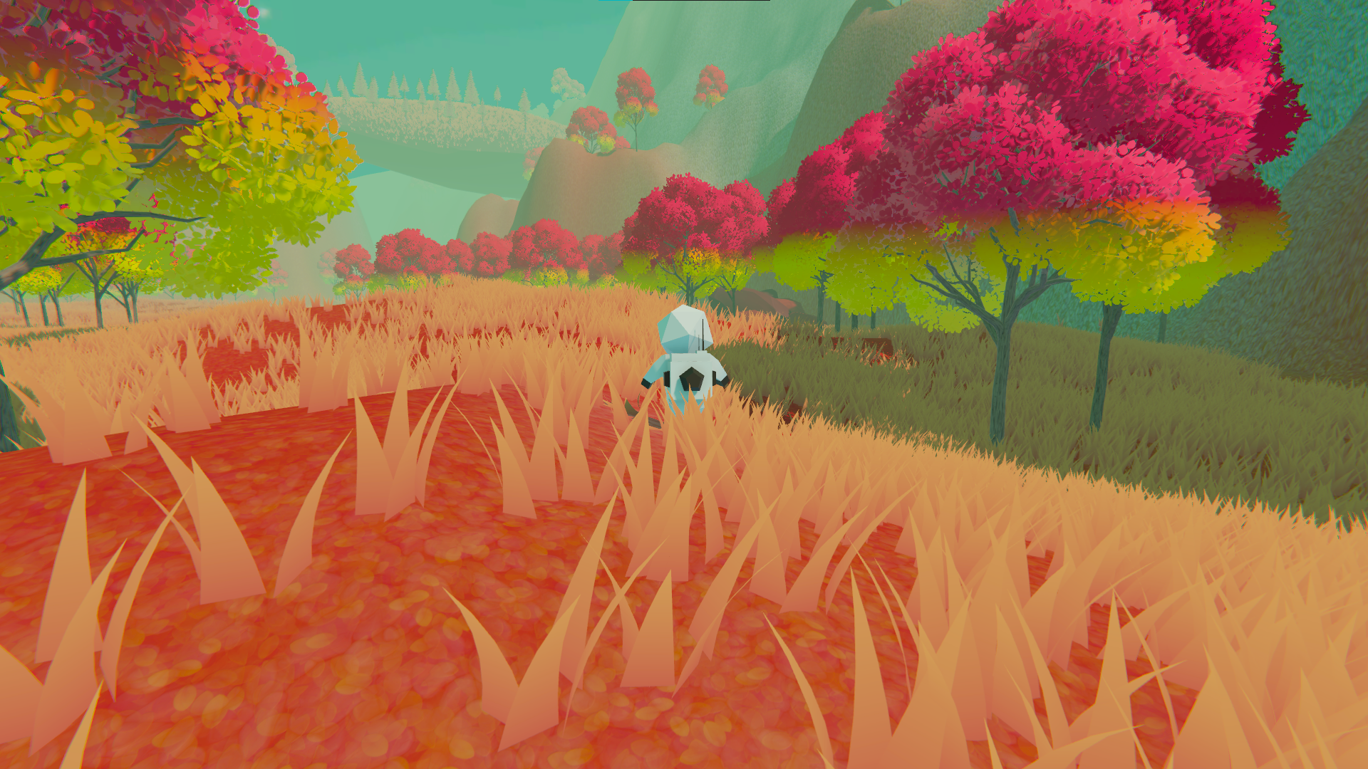
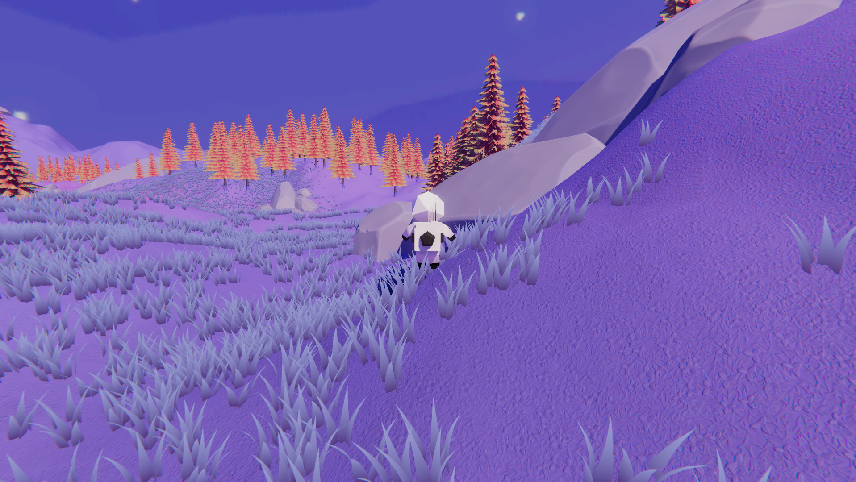
Our idea

Slide 4
Stages of development
# 2
Our idea
# 1 Forming our team
# 4
Presenting
# 3
Working on the project

Slide 5















a
The programs we used

Slide 6
Let’s jump to the project!

